Slide 1

Preseason Parents' Meeting
Together We Can Ensure A Great Experience For Our Athletes

Slide 2
3 Takeaways from TODAY:
1. ACADEMICS & ATTENDANCE
2. BEHAVIOR
3. CHARACTER

Slide 3
Reasons For A Pre-Season Meeting “Developing A Partnership”
Communication
Educate / Inform
Create Dialogue
Meet Coaches
Answer Questions

Slide 4
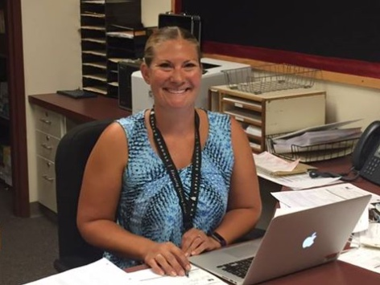
New Athletic Secretary!
Brittney Everist

Slide 5
SCHEDULES & Other Info
http://www.osaa.org
http://www.osaa.org/schools/48

Slide 6
Case for High School Activities
Higher Grade Point Average (GPA)
Better Attendance
Fewer discipline referrals
Lower drop-out rates
Higher graduation rate
Very few will be college (2%) or professional (1 in 12,000) athletes

Slide 7
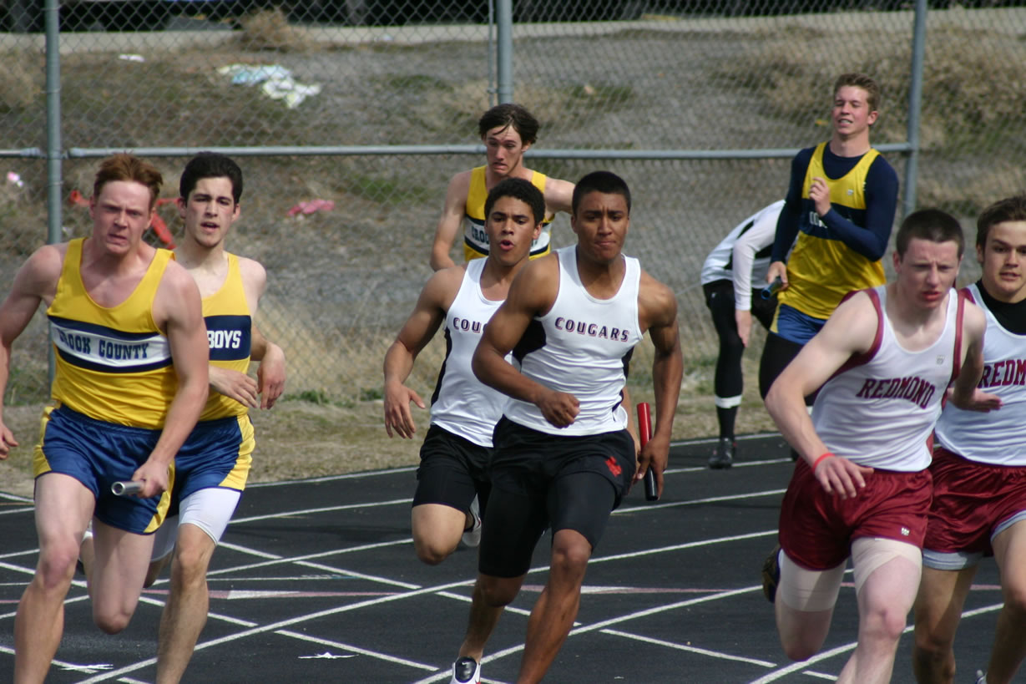

Slide 8
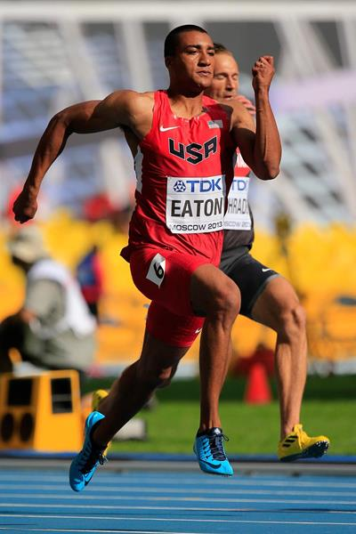

Slide 9
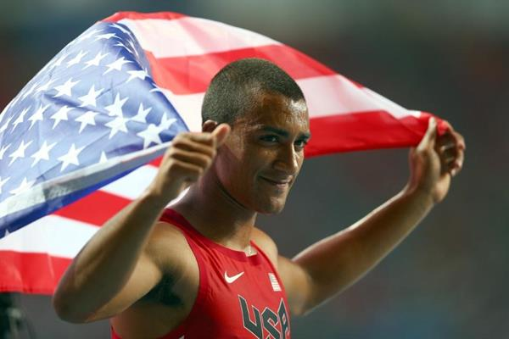

Slide 10
PARTICIPATION IN ATHLETICS
Is an integral part of the total educational process
Is a privilege
Is not a recreation league with guaranteed playing time
Promotes teamwork and camaraderie

Slide 11
ATTENDANCE
In order to participate in a practice or contest, the participant must be in school the full day of such practice or contest. Each athlete must attend school up to the time of dismissal.

Slide 12
SPORTS RISKS
In spite of protective equipment, supervision and sound instruction by coaches, there is potential for risk of injury or death in sports.

Slide 13

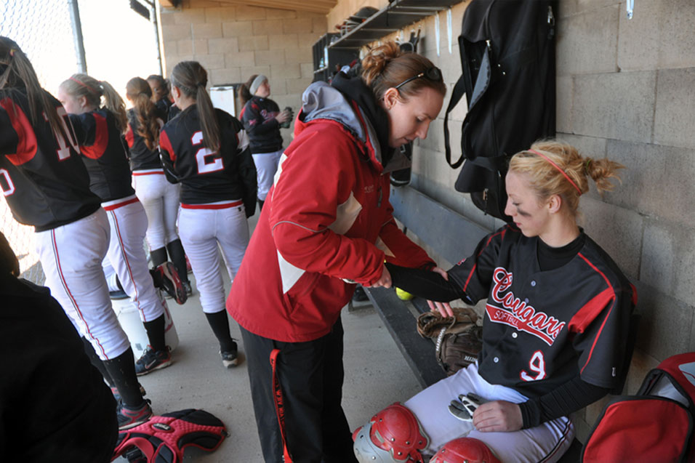
The Center Foundation
Lindsay Hagler, ATC, MS, CSCS Mountain View High School, Free Pre-Participation Exam Coordinator Undergraduate: George Fox University Graduate School: Western Michigan University

Slide 14
COACHES’ EXPECTATIONS OF PARENTS
Concerns expressed directly to the coach (other than game time)
Notification of schedule conflicts
Be publicly supportive of team accomplishments and coaching philosophy
Exhibit good sportsmanship

Slide 15
SPORTSMANSHIP EXPECTATIONS OF PARENTS
Set a positive example for our young people
Follow and support the MV “Sportsmanship Action Plan”
Cheer FOR a team, not against an opponent
No taunting, booing or yelling at opponents, coaches or officials
Profanity is not tolerated at any time

Slide 16
PARENT CONCERNS Follow the Chain of Command
Step 1 - Contact the Coach
Step 2 - Contact the Head Varsity Coach
Step 3 - Contact the Athletic Director
Step 4 - Contact the Administration

Slide 17
COUGAR BOOSTER CLUB “Join And Be Active”
Help by raising funds for athletic program
Promote school spirit
Encourage good sportsmanship
Demonstrate support for athletes

Slide 18
Nearly 7 in 10 Americans say high school sports teach students lessons about life they can’t learn in a classroom . . . ------ USA Today You should be congratulated for supporting and encouraging your son or daughter to take advantage of this educational opportunity.

Slide 19
Remember:
“Coaches open the door. You must enter on your own”

Slide 20
3 Takeaways from TODAY:
1. ACADEMICS & ATTENDANCE
2. BEHAVIOR
3. CHARACTER

Slide 21

MEET THE COACHES

